Slide 1
C language
Yashi Upadhyay, Presenter

Slide 2
Why should I learn C ?
C is a Middle-Level Language. In between the Low-level machine understandable assembly languages and High-Level user friendly languages. (Used in writing OS as well as application level programming)
Helps to understand the fundamentals of Computer Theories, such as Computer Networks, Compiler Designing, Computer Architecture, Operating Systems are based on C programming language.
Fewer Libraries as compared to other high level language.
C is very fast in terms of execution time. Functionality like Garbage Collection, preventing memory leaks etc. are not present in C.
Embedded Programming. Embedded Programming is also referred to as micro-controller programming, and C is extensively used in it. Microcontrollers and embedded programming is widely used in auto-motives, Robotics, Hardwares etc.

Slide 3
C Language Introduction
C is a procedural programming language.
Initially developed by Dennis Ritchie in the year 1972.
Mainly developed as a system programming language to write an operating system.
The main features of C language include
low-level access to memory,
a simple set of keywords (if, else), and
clean style, these features make C language suitable for system programmings like an operating system or compiler development.

Slide 4
Applications of C Programming
Operating Systems
Language Compilers
Assemblers
Text Editors: Notepad, intellij, eclipse (by the c programming, for the c programming)
Network Drivers
Modern Programs
Databases etc.
Notes:
C was initially used for system development work, particularly the programs that make-up the operating system. C was adopted as a system development language because it produces code that runs nearly as fast as the code written in assembly language. Some examples of the use of C are -

Slide 5
Compilers: Interface between a C program and machine
There are certain online compilers like
Jdoodle: https://www.jdoodle.com/c-online-compiler/
GeeksforGeeks: https://ide.geeksforgeeks.org/,
Ideone: http://ideone.com/ or
Codepad: http://codepad.org/ that can be used to start C without installing a compiler.

Slide 6
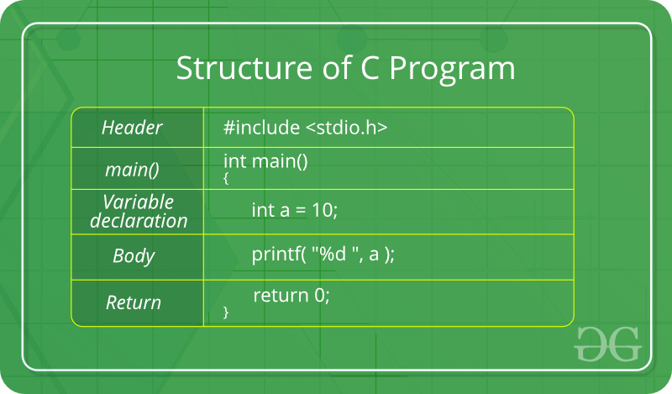
Structure of C Program

Slide 7
First program
#include <stdio.h>
int main() {
/* my first program in C */
printf("Hello, World! \n");
return 0;
}

Slide 8
Data Types
Basic Types:
integer types and
floating-point types.
Enumerated types:
They are again arithmetic types and they are used to define variables that can only assign certain discrete integer values throughout the program. (State of employee: Working/Left)
The type void
The type specifier void indicates that no value is available.
Derived types
Pointer types,
Array types,
Structure types,
Union types
Function types.

Slide 9
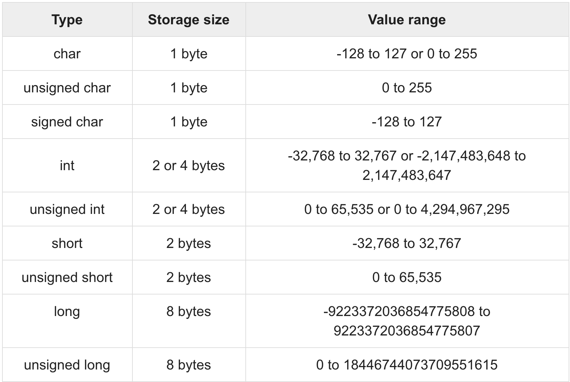
Integer types
Notes:
Declare and assign

Slide 10
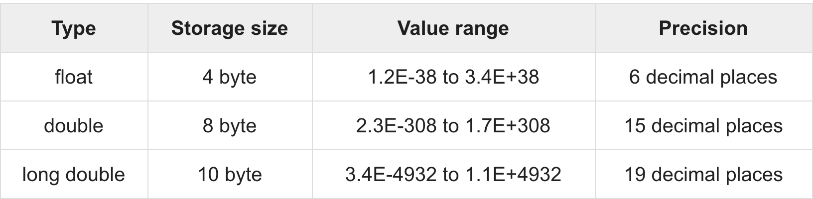
Floating-Point Types

Slide 11
String
Strings are defined as an array of characters.
The difference between a character array and a string is the string is terminated with a special character ‘\0’
Multiple ways of initializing a String
1. char myString[] = "GeeksforGeeks";
2. char str[50] = "GeeksforGeeks";
3. char str[] = {'G','e','e','k','s','f','o','r','G','e','e','k','s','\0'};
4. char str[14] = {'G','e','e','k','s','f','o','r','G','e','e','k','s','\0'};

Slide 12
The void type
Function returns as void
Function argument as void
Pointers to void

Slide 13
Example:
#include<stdio.h>
void printSum(int x, int y){
printf("Example of void: Sum %d \n", (x+y));
}
int returnSum(int x, int y){
return (x+y);
}
int main() {
int x = 5, y = 10;
printSum(x, y);
int sum = returnSum(2, 3);
printf("Example of return type int : Sum %d ",sum );
}

Slide 14
Constant
Constants refer to fixed values that the program may not alter during its execution.
Define min max in the algorithm
const float PI = 3.1415927; // maximal single float precision
const float e = 2.71; // Euler’s constant
const int email_length = 80;
Alternative: #define preprocessor.

Slide 15
Example1: Constant
#include<stdio.h>
int main() {
const int email_length = 80;
email_length++;
printf("Sum of email_length = %d", email_length);
}

Slide 16
Operators
An operator is a symbol that tells the compiler to perform specific mathematical or logical functions.
Arithmetic Operators
Relational Operators
Logical Operators
Bitwise Operators
Assignment Operators
Misc Operators
Homework: Operator precedence

Slide 17
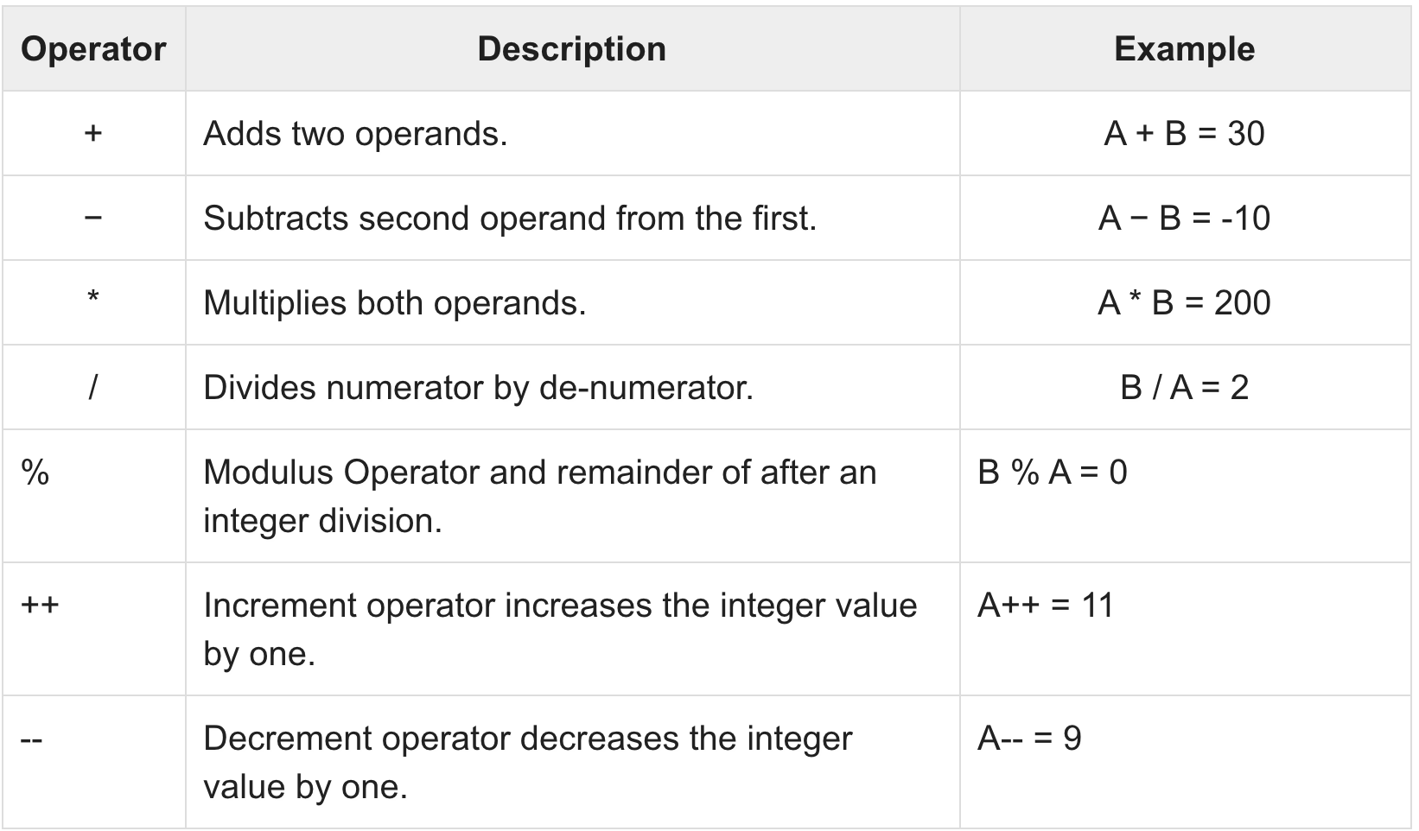
Arithmetic operator:

Slide 18
Exercise 2:
#include<stdio.h>
int main() {
int x=42949672942949;
int y=251234;
int z=x+y;
printf("Sum of x+y = %i", z);
}
Homework: How will you fix this prob, (hint: use long int)

Slide 19
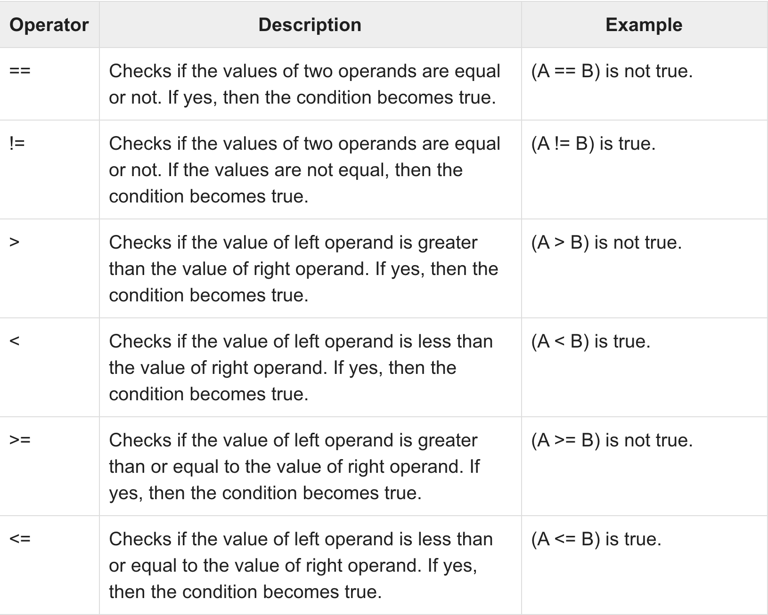
Rational operator:

Slide 20
Example 3: Rational operator
#include <stdio.h>
int main()
{
int m=40,n=20;
if (m == n)
{
printf("m and n are equal");
}
else
{
printf("m and n are not equal");
}
}

Slide 21
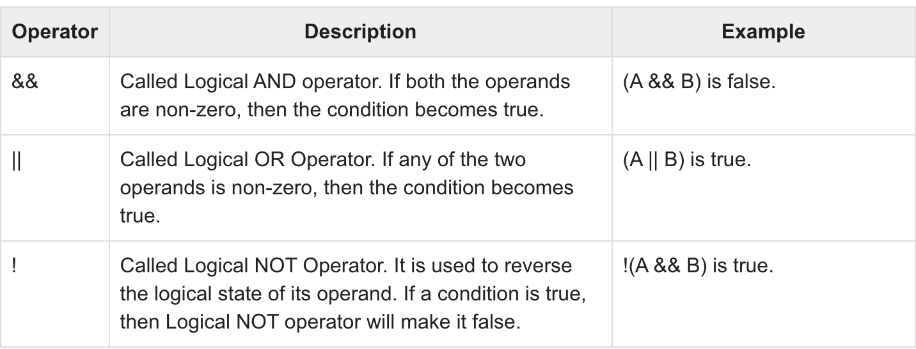
Logical Operators
Notes:
first name lastname email

Slide 22
Example 4: Logical operator
#include <stdio.h>
main() {
int a = 5;
int b = 20;
int c ;
if ( a && b ) {
printf("Line 1 - Condition is true\n" );
}
if ( a || b ) {
printf("Line 2 - Condition is true\n" );
}
}
Homework: True when both a & b are 0 (a && b, a = 0, b = 3 )

Slide 23
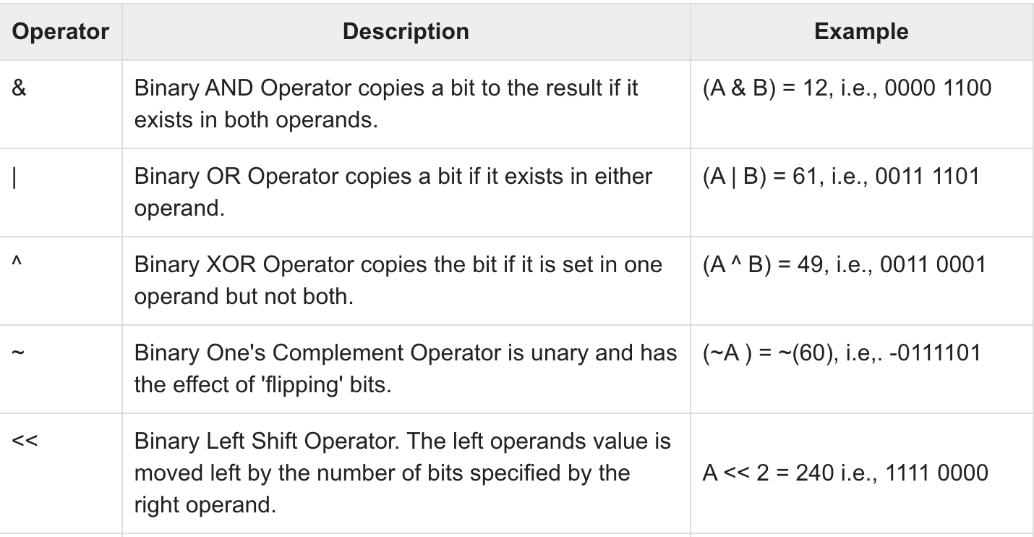
Bitwise operator
Notes:
Decimal values are converted into binary values which are the sequence of bits and bit wise operators work on these bits.

Slide 24
Example 5: Bitwise
#include <stdio.h>
int main()
{
int a = 12, b = 25;
printf("Output = %d", a&b);
return 0;
}
12 = 00001100 (In Binary)
25 = 00011001 (In Binary)
Bitwise AND Operation of 12 and 25
00001100
| 00011001
________
00001000 = 8 (In decimal)
Homework: XOR on same numbers

Slide 25
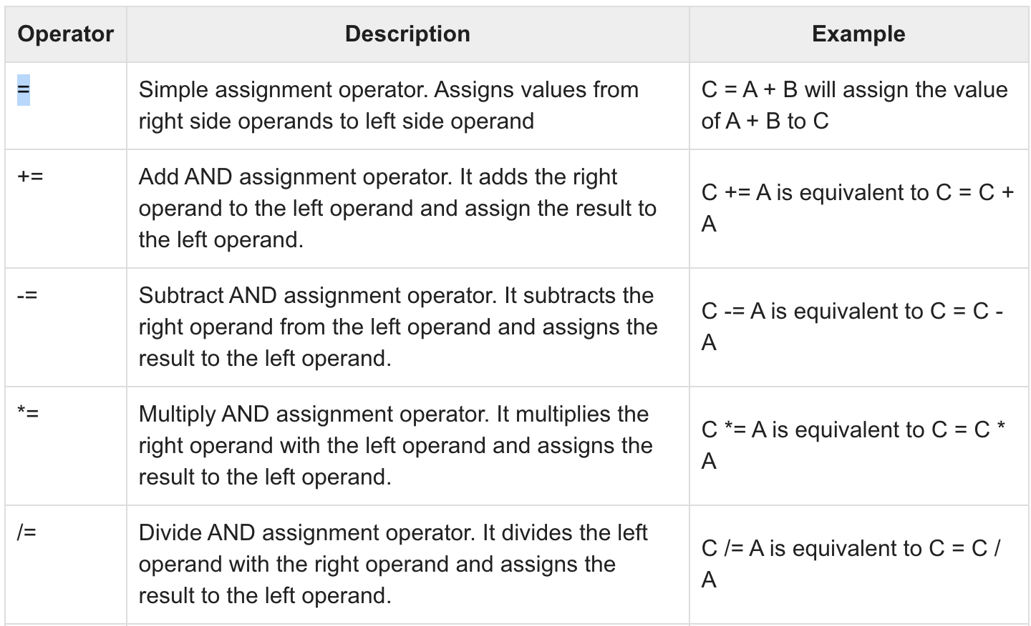
Assignment Operators

Slide 26
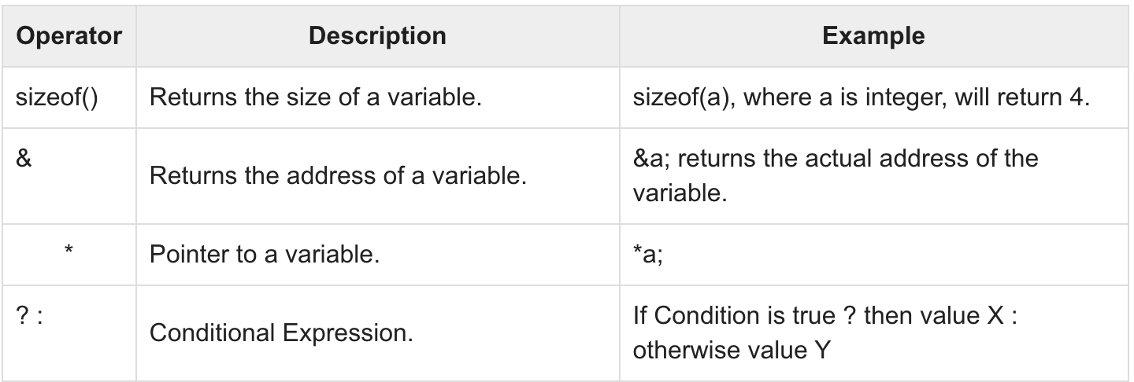
Misc Operator

Slide 27
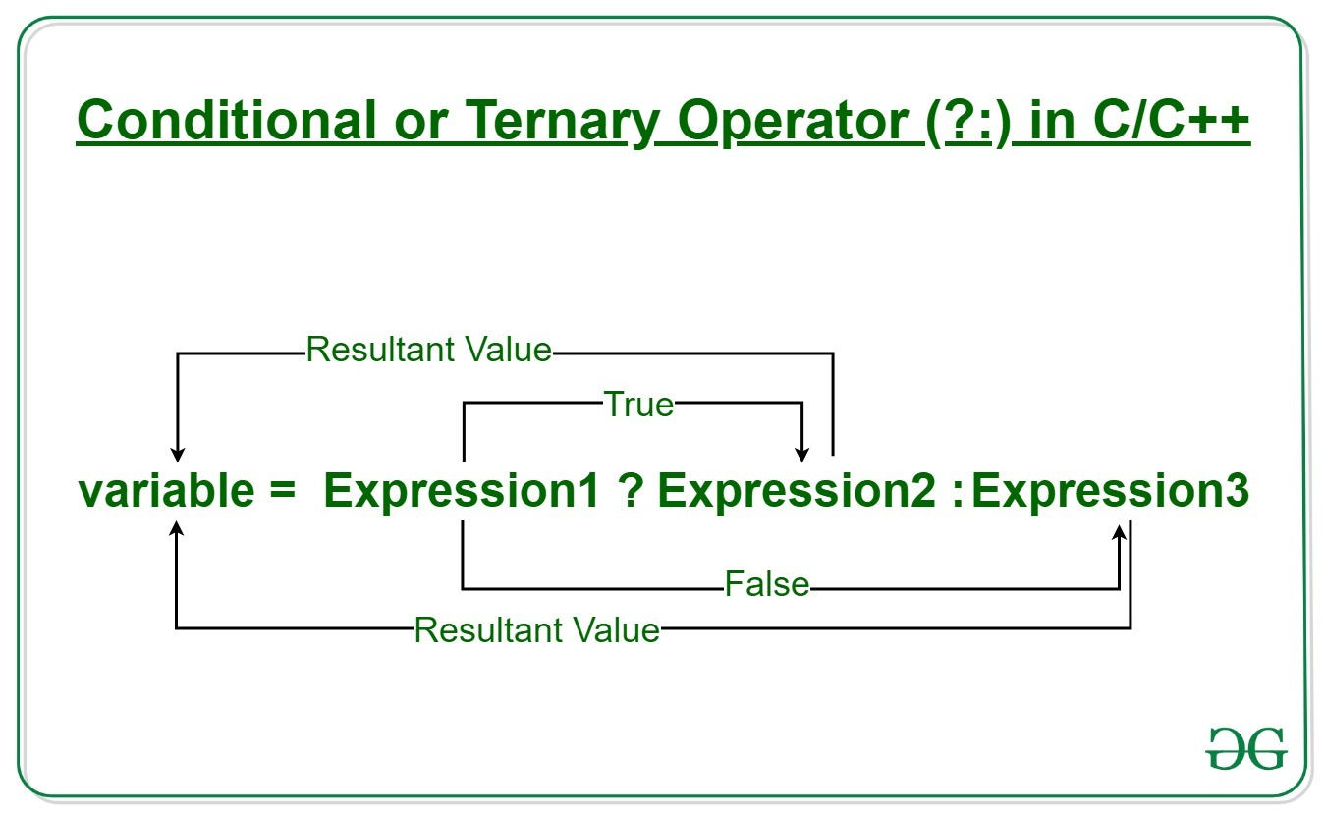
Ternary operator

Slide 28
Exercise6:
#include <stdio.h>
int main(){
int n1 = 5, n2 = 10, max;
max = (n1 > n2) ? n1 : n2;
// Print the largest number
printf("Largest number between %d and %d is %d. ",n1, n2, max);
return 0;
}
Homework: Put n1 = 20, and n2 = 15 and find the max from the program.

Slide 29
Thank you

